Slide 1
Come Away to Bethany For A Personal Encounter with christ

Slide 3
“Come to Me All you that labor and are burdened and I will give you rest.” Mt. 11:28

Slide 4
“I invite all Christians to a renewed personal
encounter with Christ.” Pope Francis

Slide 6
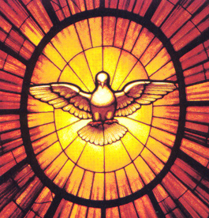
CMA Men’s Physicians Retreat
Living in the Power of the Gifts of the Holy Spirit
Instaurare Omnia in Christo Eph.-1:10
Retreat Master
Father Christopher Kubat, MD
Diocese of Lincoln

Slide 7
Living in the Power of the Gifts of the Holy Spirit
I kneel before the Father…that He may grant you to be strengthened with power through His Spirit…that Christ might dwell in your hearts…that rooted and grounded in love…you may be filled with all the fullness of God.
Eph. 3:14-19
The shortest way to holiness is faithfulness to the inspirations of the Holy Spirit Diary of St. Faustina

Slide 8
Praying with Mary Our spiritual mother
“When the Holy Spirit has found Mary in a soul, He flies there. He enters there in His fullness; He communicates Himself to that soul abundantly, and to the full extent to which it makes room for His spouse.”
St. Louis de Montfort
True Devotion to Mary #36

Slide 9
“The time is ripe to bring together the greatest minds from medicine, law, business and theology under the guidance and support of our Bishops, to formulate the very best models for Catholic healthcare – models that are sustainable and replicable. Now is the time to rise up, inspired by the Holy Spirit and the Blessed Mother, to create entirely new approaches that will not only bring faithful medicine to our people, but bring our people to a deeper relationship with God.”
The Pulse Summer 2018

Slide 10
CMA Men’s Physicians Retreat
Living in the Power of the Gifts of the Holy Spirit
Instaurare Omnia in Christo Eph.-1:10
Retreat Master
Father Christopher Kubat, MD - Diocese of Lincoln
April 30 (7PM) – May 3, 2020 (Noon)
Bethany Retreat House Nashville, TN
REGISTER SOON SPACE LIMITED
CONTACT : Dr. Steve White rswmd52@gmail.com

